Slide 1
Trojan, Virus and Worms

Slide 2
What is Virus
A computer virus is a computer program that can copy itself and infect a computer without permission or knowledge of the user.

Slide 3
How it works
Viral code is attached or “inserted” into the order of execution so that when the legitimate code is run the viral code is also run or run instead of the legitimate code.
Using Batch programming we can perform that

Slide 4
What is Worm
Worms are a subset of viruses
The differ in the method of attachment; rather than attaching to a file like a virus a worm copies itself across the network without attachment.
Infects the environment rather than specific objects
Morris Worm, WANK, CHRISTMA, EXEC

Slide 5
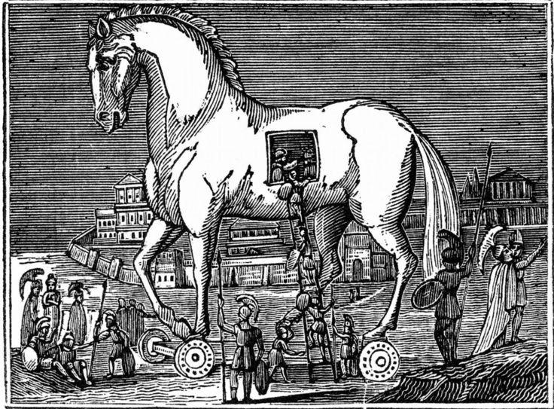
What is Trojan
Non-replicating programs that run in the background of the legitimate looking program.

Slide 6
Trojan Creation
Using Beast
Other softwares

